Slide 1
DPLL over fiber for low cost Two-Way Time Transfer

Slide 2
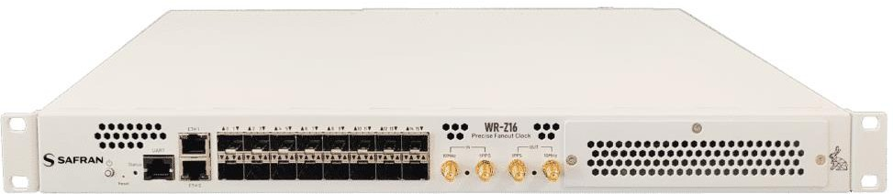
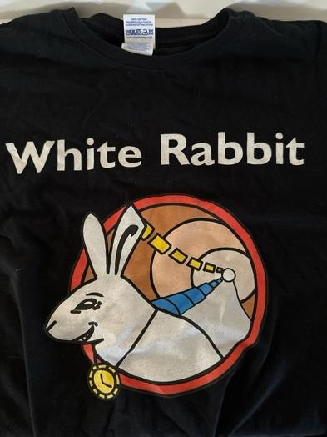
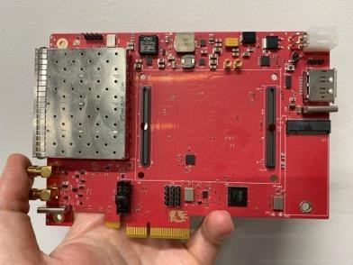
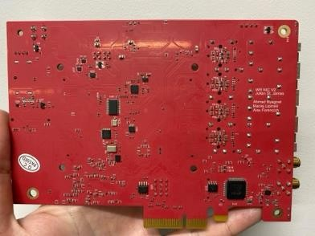
Why New system for Two Way Time Transfer?
PTP can cheaply do time transfer to sub microsecond level
Time Stick at cheapest, USB to Ethernet
Current Sub-Nanosecond Solution: White Rabbit
Based on expensive FPGAs with transceivers
Mostly 1G Ethernet, 10G is recently released
Complex FPGA design to make a custom solution
Most White Rabbit deployments are in parallel to Data Network at higher speeds like 100G/200G/400G/etc. If it’s only used for Time and frequency, why pay the cost of Ethernet + FPGA?
To democratize sub-nanosecond time distribution and measurement, need a cheaper solution that is simpler
Open disclaimer: I have no problems with White Rabbit, I wear White Rabbit swag (thanks Maciej for the shirt) and spun a White Rabbit Prototype NIC with Alex, Ahmad, and Maciej!

Slide 3
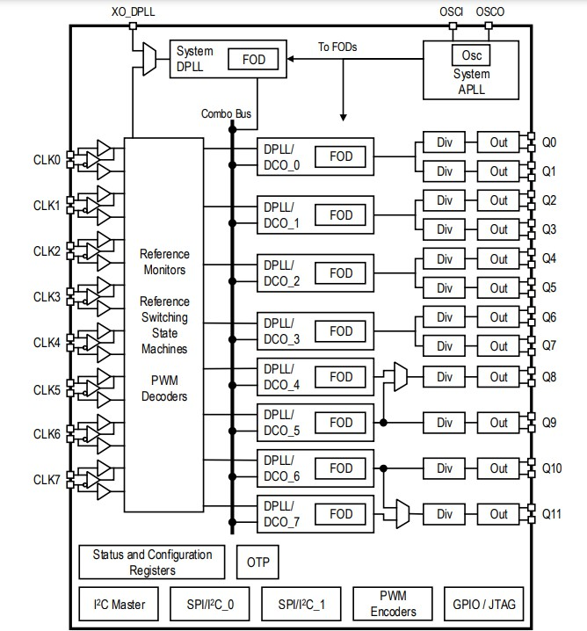
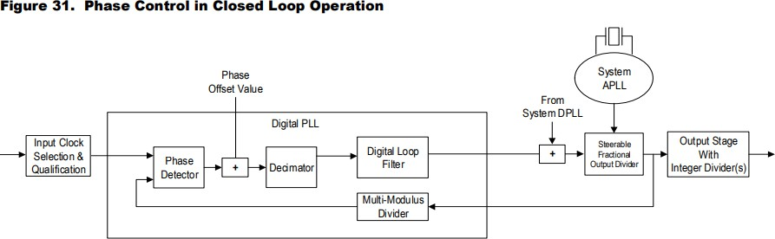
DPLL
Powerful clocking chips with multiple clocking inputs and outputs
Can generate multiple output frequencies from known input frequencies
Can synchronize outputs using 1PPS
(Time) input and Frequency input
Renesas 8A34001 Diagrams

Slide 4
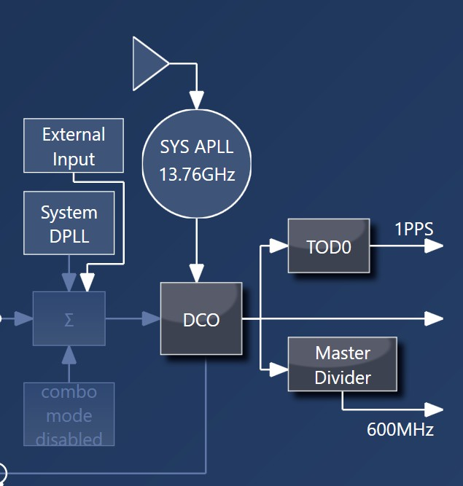
DPLL main building blocks
TDC (Time-to-Digital Converter)
Measures time difference or phase
between two incoming signals
This digital phase measurement is
filtered and used to digitally create a PLL
In Renesas 8A34001
Input TDC can measure 50 picoseconds between two inputs, 1 ps given multiple measurements and time to decimate
Input TDC can be used for DPLL operation, or just for high precision measurement, even for 1PPS signals
TOD ( Time of Day )
Allows timestamping with respect to adjustable Time of Day (similar to PHC)
Renesas 8A34001 Diagrams

Slide 5
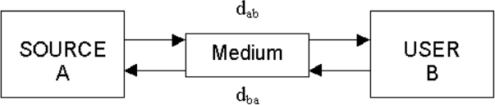
TWTT Components
Three main components for high accuracy
time transfer
A frequency signal
Ensures stable time in between time signals
Sync-E for Ethernet Networks
A time signal
In PTP , this is a timestamp on Ethernet frame
Small data
Example: Clock quality information, Time of
Day, GNSS Quality

Slide 6
Frequency transfer
Core purpose of DPLL is frequency
propagation
Known input, generate outputs
from that
Side note: “Low” speed SFPs, 1G / 10G transceivers, can pass clock signals above about 10MHz!

Slide 7
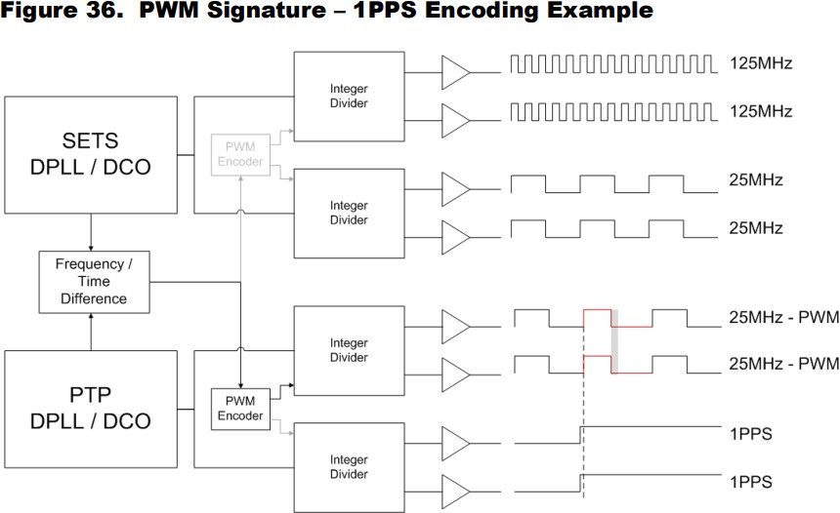
Time transfer
Most DPLLs support ePPS
Embeds / associates a time
signal (1PPS) with a clock signal
PWM of clock signals which clock edge is associated with time signal
Can also extract this ePPS and
output as discrete 1PPS signal
Renesas 8A34001 Diagrams

Slide 8
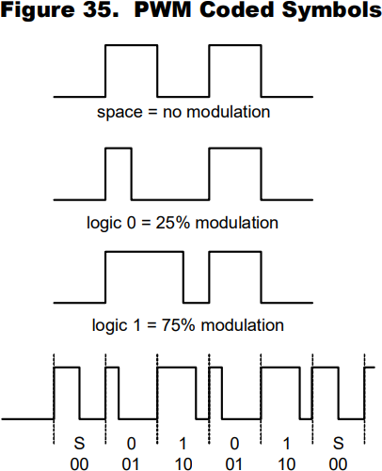
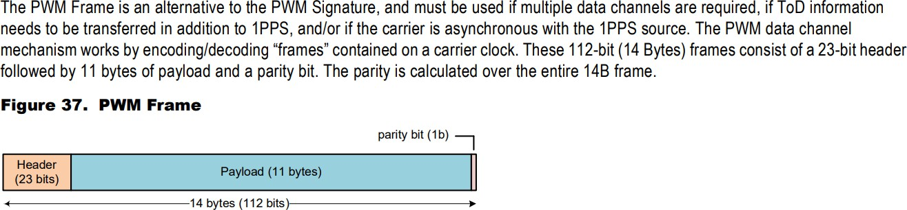
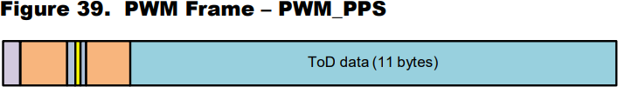
Small data transfer
Renesas DPLLs support PWM data transfer
After ePPS signal, continues to modulate clock width to encode frame(s)
Two mechanisms
TOD frame, 11 bytes payload
6 bytes seconds, 4 bytes nanoseconds, 1 byte sub-nanosecond
6 bytes of seconds = 8,918,062 years!
4 bytes of seconds = 136 years
PWM FIFO
Read/write FIFO, 128 bytes
TOD + FIFO allows arbitrary two way user data transfer
Renesas 8A34001 Diagrams

Slide 9
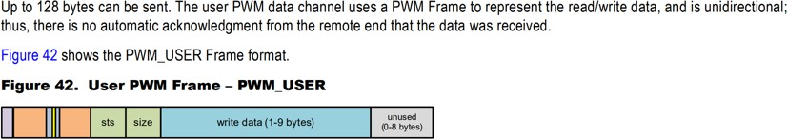
Small data transfer (cont.)
PWM FIFO can only be receiver or transmitter at one time. How to coordinate when to transmit and when to receive?
Created hand-shake protocol using upper two bytes of TOD as flag, PWM FIFO as data
Byte[5] bit 7 is “user TOD” flag
Byte[5] bits 6:5 are handshake flag, similar to SYN / ACK from TCP
Byte[5] bit 4 is signal from follower, telling leader it is now following TOD and frequency
Byte[5] bits 3:0 are Transaction IDs, operations to perform, like query input status, query name, etc.
Byte[4] is random byte, collision negotiation
TOD sent every second normally by DPLL, creates slow but coordinated data channel to transfer 128 bytes

Slide 10
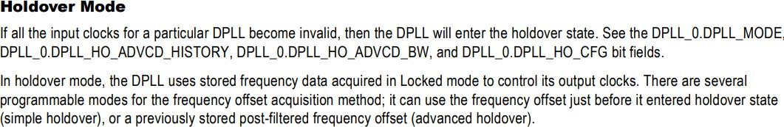
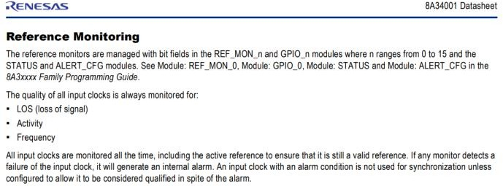
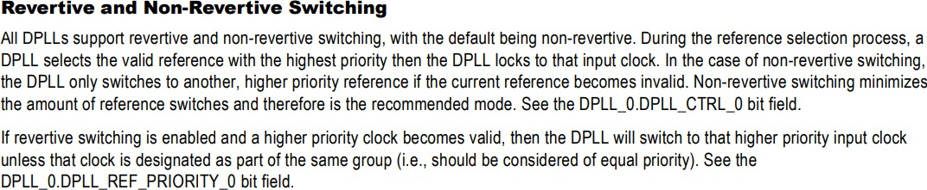
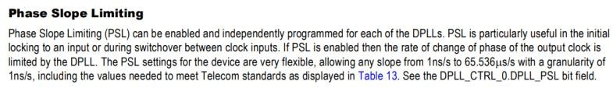
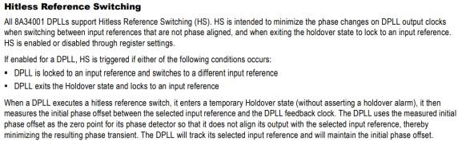
What about system level implementation?
System level has more requirements than just transferring 1PPS
Holdover operation when reference is lost
Input Qualification, quality and presence
Loss of signal
Frequency deviation
Automatic switchover
Hitless switchover between sources
Slowly adjust to new phase, or use new frequency but hold previous phase
Phase change limit, prevent large jumps
All of these features allow a system using DPLLs to manage multiple inputs in hardware, with minimal impact to output quality

Slide 11
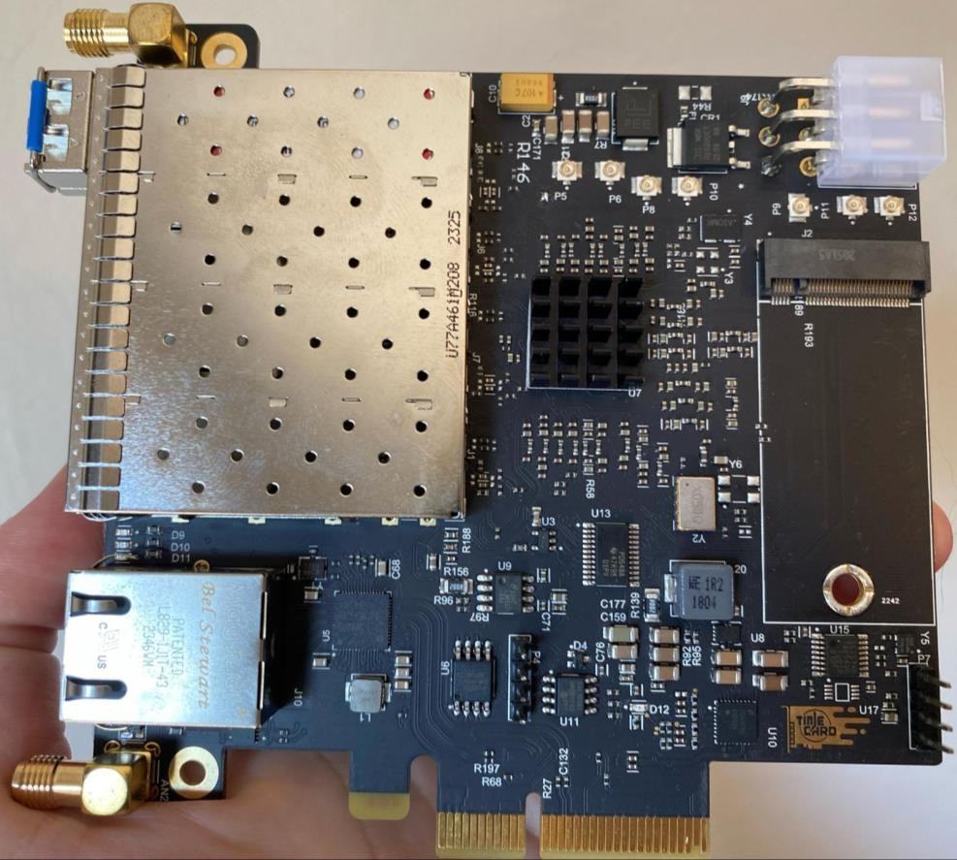
Hardware design
“DPLL over Fiber” design
I225 NIC
8A34001 DPLL
4 SFP connections for bidirectional links
SiT5501 “Super-TCXO” Local Oscillator,
+/- 10ppb
2 SMA, software controllable Input or
Output
U.FL for any spare DPLL inputs or
outputs
Clock buffer for 100MHz to DPLL, for PFM implementation
M.2 GNSS Slot

Slide 12
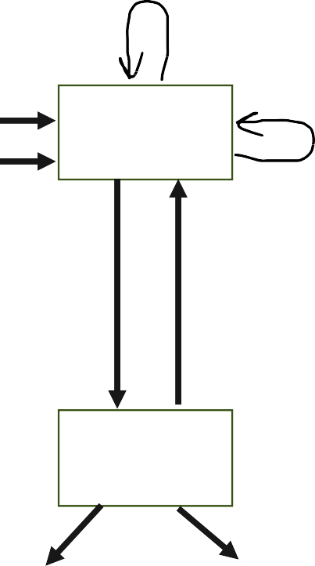
Time transfer in design
1PPS sending to follower
Signal sent over SFP is 25MHz + 1PPS + PWM TOD
25MHz = Frequency
1PPS = Time
PWM TOD = Data
Ref 10MHz Ref 1PPS
Leader
1PPS from Follower
How is the delay compensated?
Two-Way Time Transfer!
SFP Link
25M + 1PPS
In beginning, 1PPS to follower is same as reference 1PPS
Two measurements, use Input TDC on DPLL
Meas1: Round trip, 1PPS sending to follower vs 1PPS from follower
Meas2: Reference versus sending, Reference 1PPS vs 1PPS sending to follower
Error signal: (Meas2 – Meas1/2) , difference between reference and sending to follower and half the round trip (assumed to be 1 way delay)
Leader software creates small frequency step to shift signal sending to follower, then removes frequency step, and remeasures
Follower
Frequency out, ex. 10MHz
Time out, 1PPS

Slide 13
What about Ethernet? Host?
I225 chipset on board
Provides access to
PTP / Ethernet Domain
PTM / PCIe (Host CPU) domain
4 Software Defined Pins (SDP) on I225
SDP3 / SDP4 , bitbang I2C to control DPLL
SDP0 as PHC Timestamper Input
Connected to DPLL input
Allows sending 1PPS to DPLL domain as reference
SDP1 as PHC Output
Connected to DPLL output
Allows receiving 1PPS from DPLL domain as reference
Can bridge between DPLL over Fiber either to/from PCIe & PTP!
DPLL
SDP0 PPS
SDP1 PPS
I2C
I225
RJ45,
Ethernet
PCIe to motherboard (PTM)

Slide 14
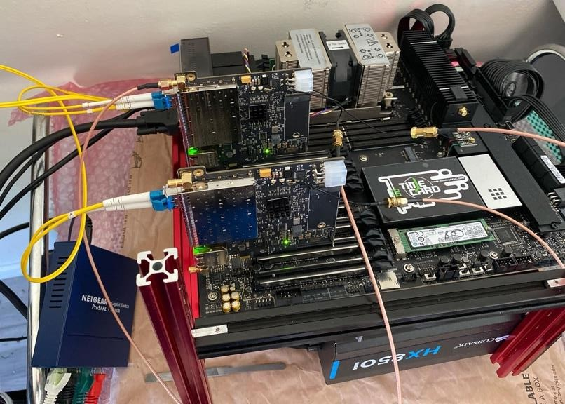
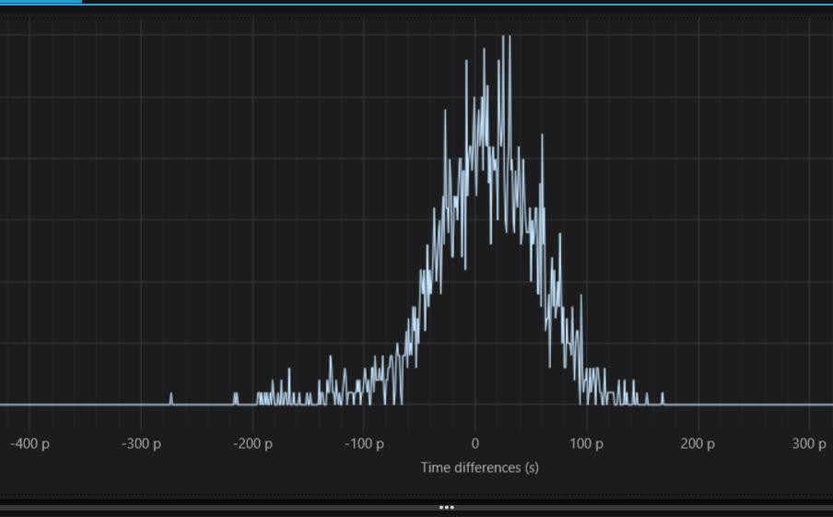
Hardware TWTT Results
Swabian TimeTagger measures time difference between two boards, +/- 34 ps noise
With minimal software initial compensation, time transfer within +/- 300 picoseconds for 4 hours with no software monitoring or intervention, majority of samples within +/- 200 picoseconds, over 10G LR SFP+ transceivers

Slide 15

Using TWTT
Time measurement using SMA or U.FL internal
Input TDCs on DPLL can measure two 1PPS signals to 50 picoseconds if they’re stable with respect to each other
TOD Timestamp Input on DPLL can timestamp single external input events to 1 nanosecond resolution, similar to PHC timestamp
Frequency measurement
Input TDC will accumulate phase error, can measure frequency offset between two sources based on accumulated phase
Arbitrary adjustable output frequency, from PP2S to 1GHz

